Slide 1
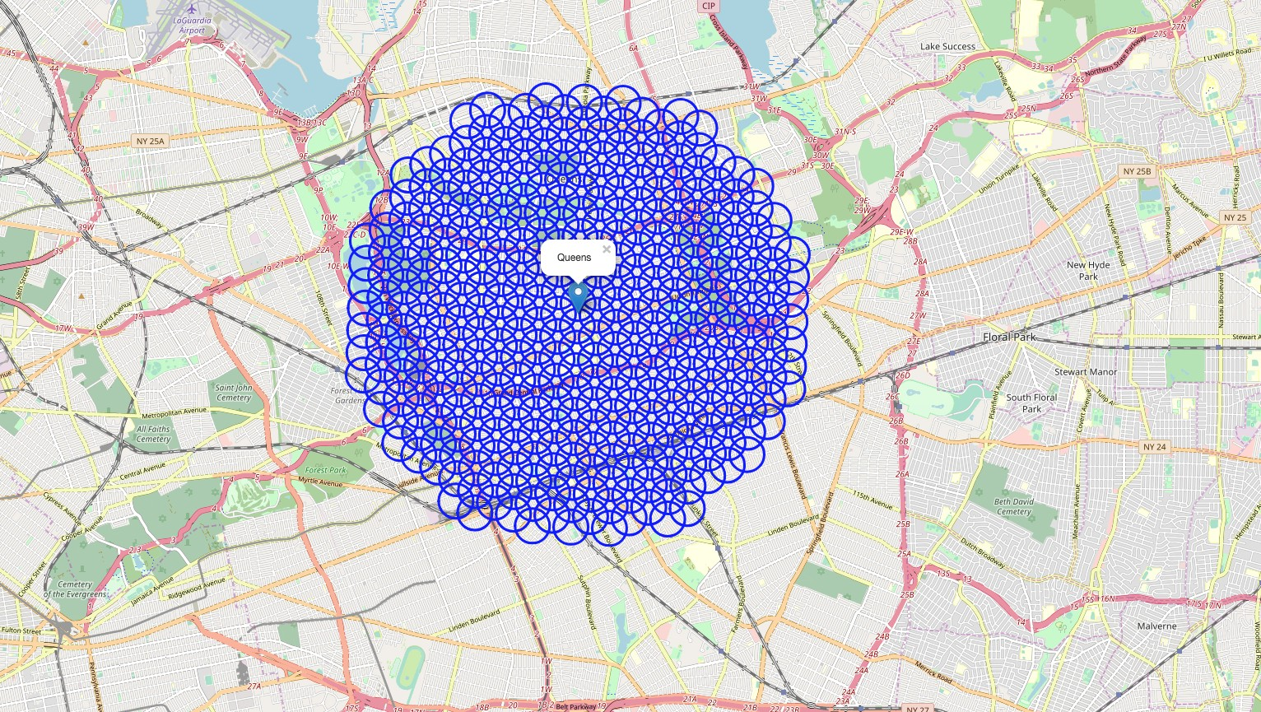
Cluster QUEENS CENTERS’ RESTAURANT CANDIDATE LOCATION

Slide 2
RESTAURANT TYPE AT QUEENS CENTER
There are a lot of different restaurants in Queens.
Maybe there is different character at each area
Analyze the cluster character can help the skate holders: location cluster and restaurant type
Cluster the candidate location for helping operation team:
Analyze the current restaurant type
Cluster the different restaurant type in each cluster

Slide 3
DATA ACQUISITION AND cleaning
Google API:
Use Google API to get the Queens location—longitude and latitude
Get the candidate location geometry information
Foursquare API:
Get the restaurants information and the schools information by using Foursquare API
Create candidate location:
calculate the 364 candidate location
Data flow:
Get the Queens geometry information
Calculate candidate geometry information, under the conditions, like ~6 km from Queens center, and each are
has 600 meters each circle apart
Get the detailed information in each circle by using Foursquare API

Slide 4
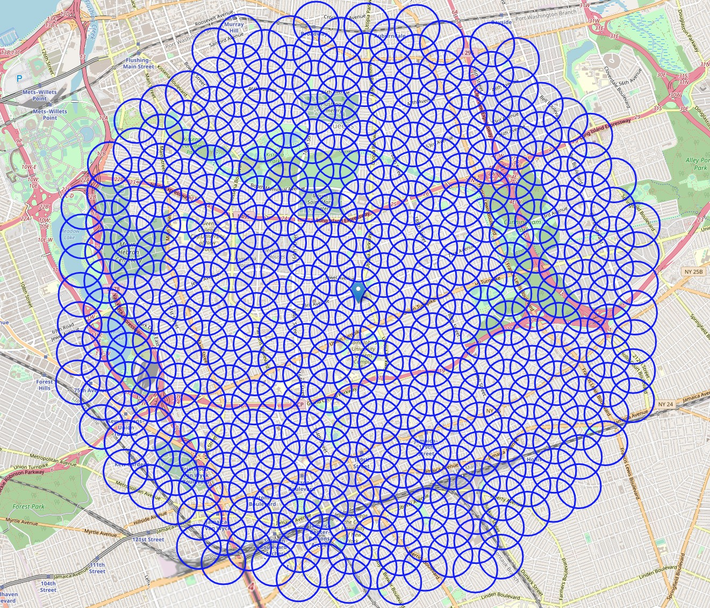
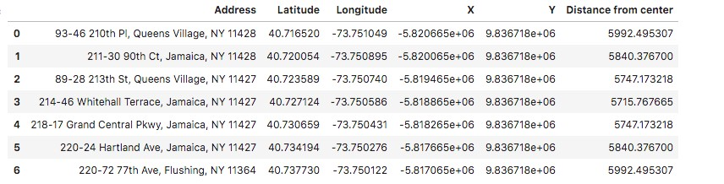
DATA FLOW
Google API
Queens geometry information
Create Candidate
calculate candidate location
FourSquare API
restaurants and schools

Slide 5
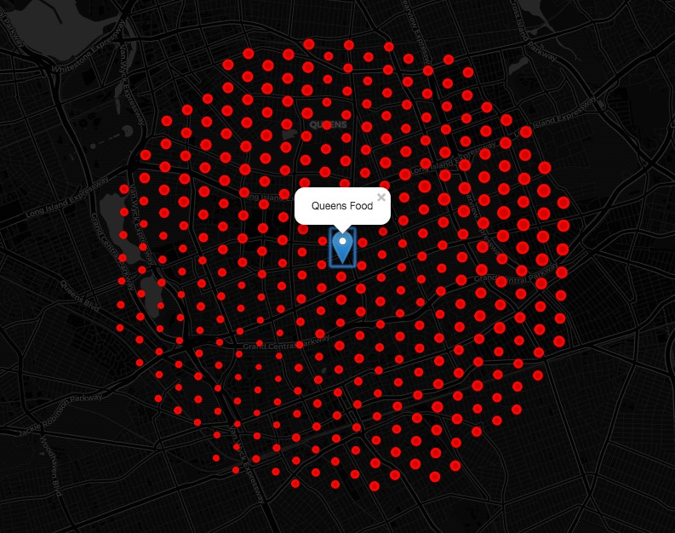
RESTAURANT INFORMATION
The restaurants is almost uniform in the each candidate location.Therefore, add the school information to analyze

Slide 6
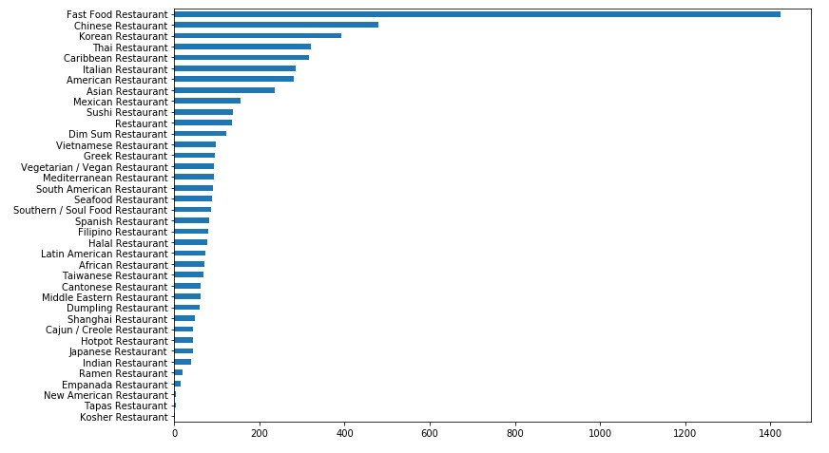
RESTAURANT NUMBER
We can find some information, like that the fast food restaurant is main type in the Queens center, and the second type is the Chinese restaurant.Top 3 restaurant:
Fast Food Restaurant
Chinese Restaurant
American Restaurant

Slide 7
CLUSTER FLOW
Feature Selection
drop unnecessary features
Preprocess Data
scale data
Reduce Dimensions
PCA
Build Model
KMeans

Slide 8
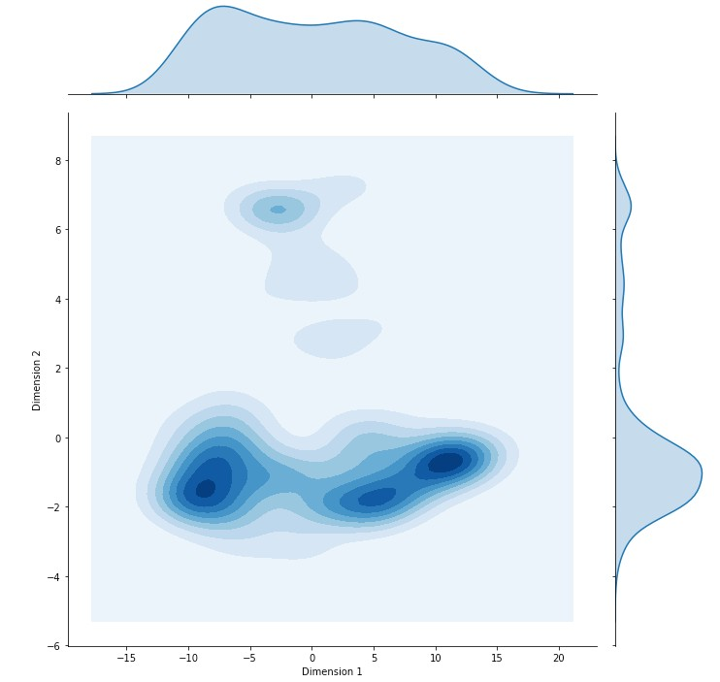
PCA RESULT
Analyze the main two components KDE visualization.
We can find that there are four clusters

Slide 9
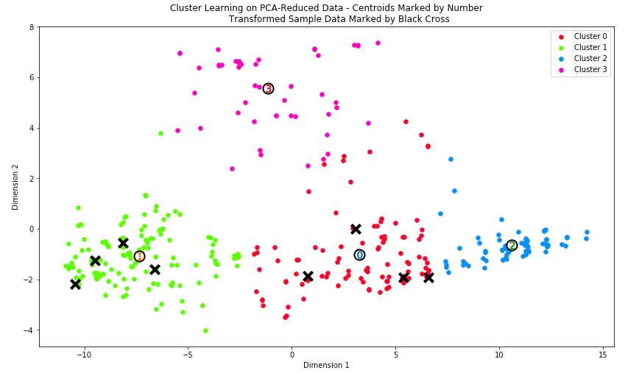
CLUSTER REPORT

Slide 10
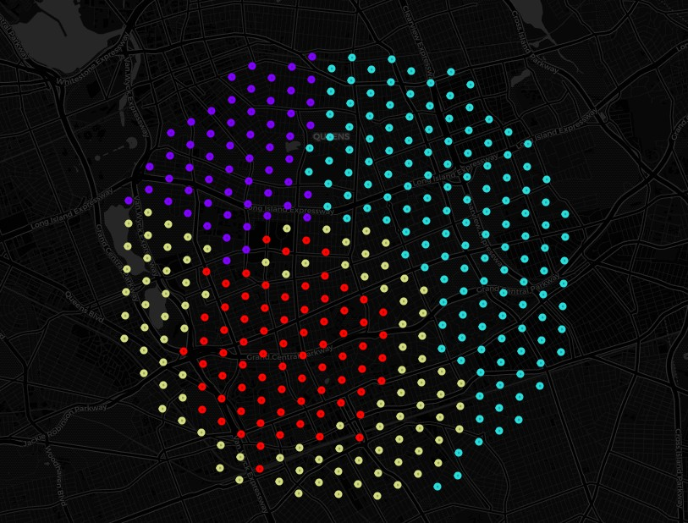
CLUSTER REPORT

Slide 11
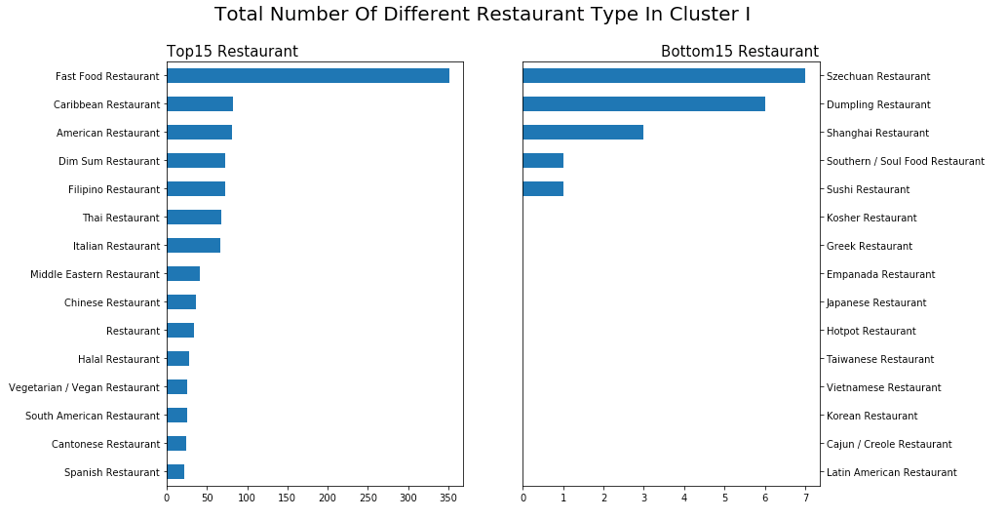

CLUSTER I REPORT
Cluster I Candidate Location Fast Restaurant is main type
Western Restaurants have the largest market Eastern Restaurants have the few market

Slide 12
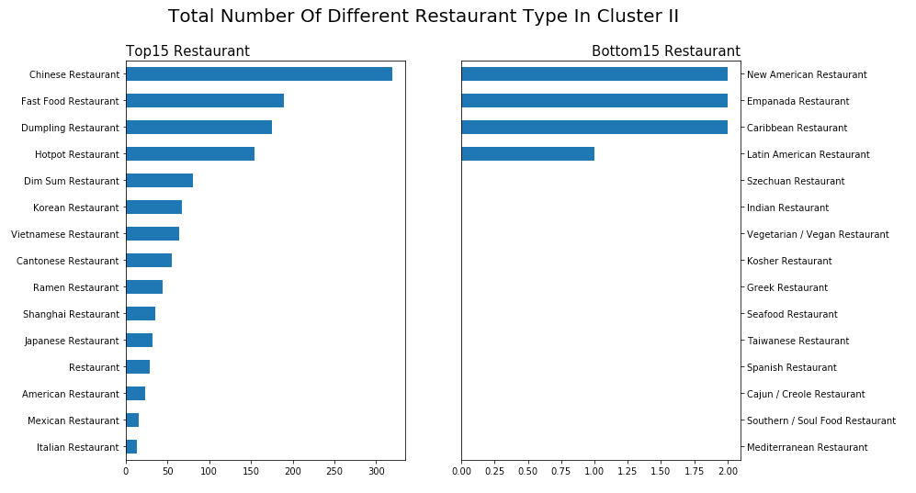
CLUSTER II REPORT
Cluster II Candidate Location Chinese Restaurant is main type
Asian Restaurants have the largest market, like Chinese Breakfast restaurant Western Restaurants have the few market

Slide 13
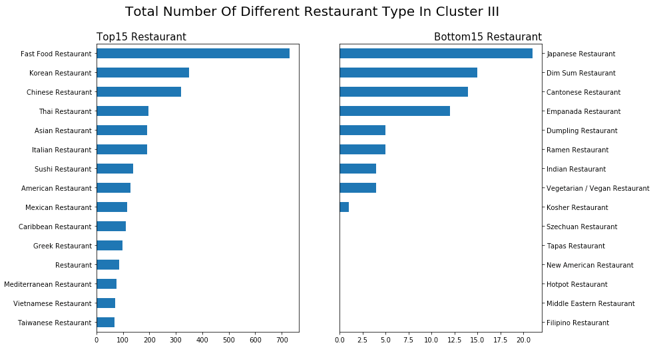
CLUSTER III REPORT
Cluster III Candidate Location
Fast Food Restaurant is main type
The candidate location has mixture restaurant type.Asian Restaurants and western restaurant are same important type the Asian restaurant is lack of variety
The candidate location is a good choice to open an Asian restaurant. Maybe the Chinese Breakfast restaurant is a good idea

Slide 14
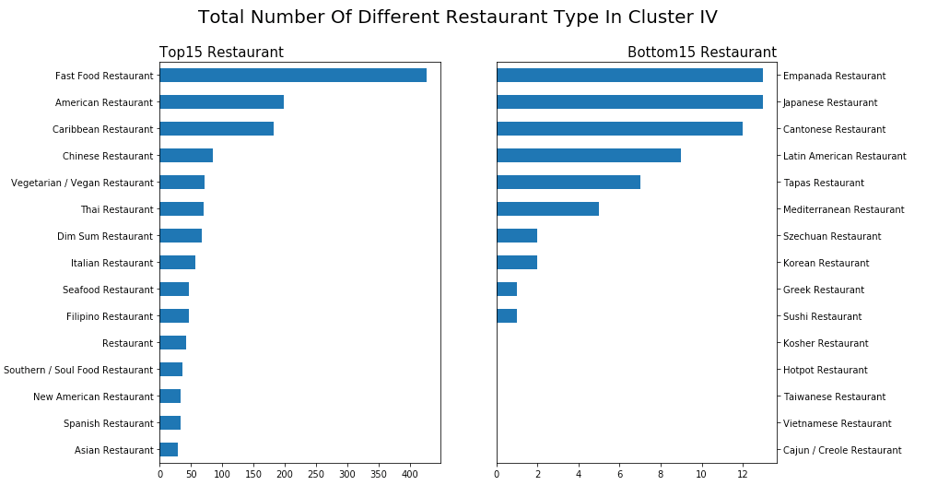
CLUSTER IV REPORT
Cluster IV Candidate Location
Fast Food Restaurant is main type
The candidate location has mixture restaurant type
Asian Restaurants and western restaurant are same important type the Asian restaurant is lack of variety.The candidate location is a good choice to open an Asian restaurant. But the southeastern Asian restaurant is not a good idea

